Slide 1
Reducing Violence and Building Skills: The Role of a Behavior Support Team in Psychiatric Care
Renuka Ananthamoorthy, MD
Jennifer Morrison-Diallo, BCBA
Liliane Rocha, BCBA
Kings County Hospital Center

Slide 2
The Journey

Slide 3
Behavioral Health - Kings County Hospital
236 Acute inpatient beds
8,000 CPEP visits/year
47,800 Mental Health visits/year
Huge Chemical Dependency program includes detox, OTP, rehab clinic, 25 bed residential program
BH Primary care visits ≈ 4,580 /year
Inpatient admission/discharges ≈ 4,275 /year
Innovative programs: KOT, Early Episode Unit, BHPCC, Recovery Center, ICST, Peers, RARC, CPA Programming, BST

Slide 4
The Burning platform
Death of a patient in the psychiatric ER
Consent agreement with DOJ
Regular site visits by DOJ
The system needed a build up from the foundation
New policies needed to be written
Communication needed to be improved
Safety was the number one priority

Slide 5
To enhance communication & safety
SBAR communication was built up
Crisis Management Unit (CMU) was created
Unit staff assumed clearly defined roles during a crisis:
Greeter
Observer
Point Person
Runner
Communicator
Staff Supporter

Slide 6
Challenging behavior
Early identification of patients who may need more
Frequent visits to CPEP
Special Incident Review Committee (SIRC)
List of repeated incidents by patient
To integrate the information with the interdisciplinary team
Structured morning report
30 minute hand off meeting in the afternoon
For patients who needed even more, referral to the Behavior Support Team (BST)

Slide 7
The Behavior Support Team

Slide 8
Behavior Support Team (BST)
Created in 2010 as a response to DOJ mandate
Directed by a neuropsychologist
Staffed by 1 Behavior Analyst, and 2 Cognitive Behavioral Psychologists, and one Occupational Therapist
In late August 2012
New director (BCBA)
Between September 2012 and May 2013 staff turn over
By January 2014, team is fully staffed with different composition

Slide 9
BST Composition and Scope
Serves all inpatient units (205 beds)
4 Behavior Analysts (+ Director)
3 data collectors
1 nurse
Externs (Psychology and Behavior Analysis)
Provides
Individualized Behavior Plans (IBP)
Contracts
Engagement Schedules
Token reward systems
Behavioral training

Slide 10
Target Response Classes
Physical aggression
Hitting, punching, SIB, spitting
Property destruction (breaking computers, punching wall)
Verbal aggression (threatening, name calling)
Hyper-sexualized behaviors (public masturbation, exposure)
Treatment refusals (non-adherence to medication, isolative behaviors)
Other (defecating /urinating in public, inserting small objects in body cavities, pica)

Slide 11
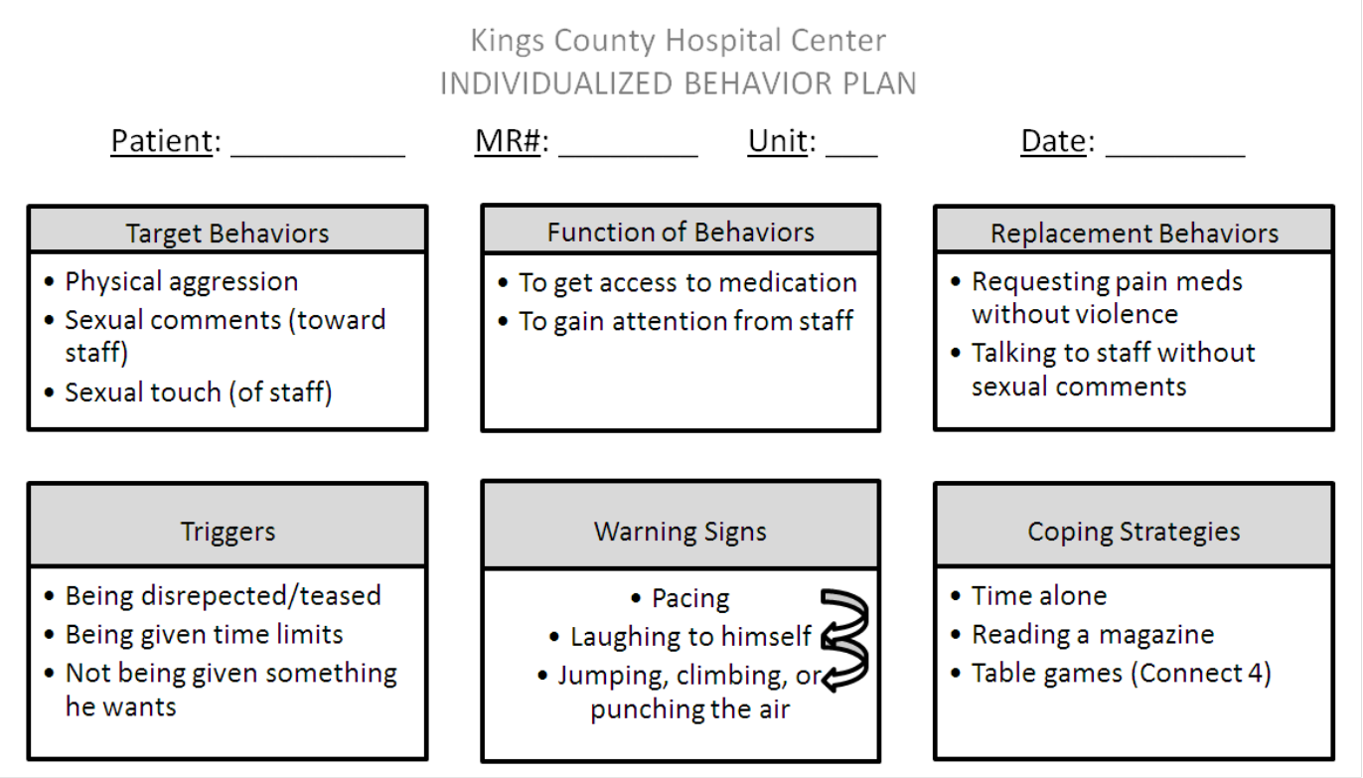
Individualized behavior plan

Slide 12
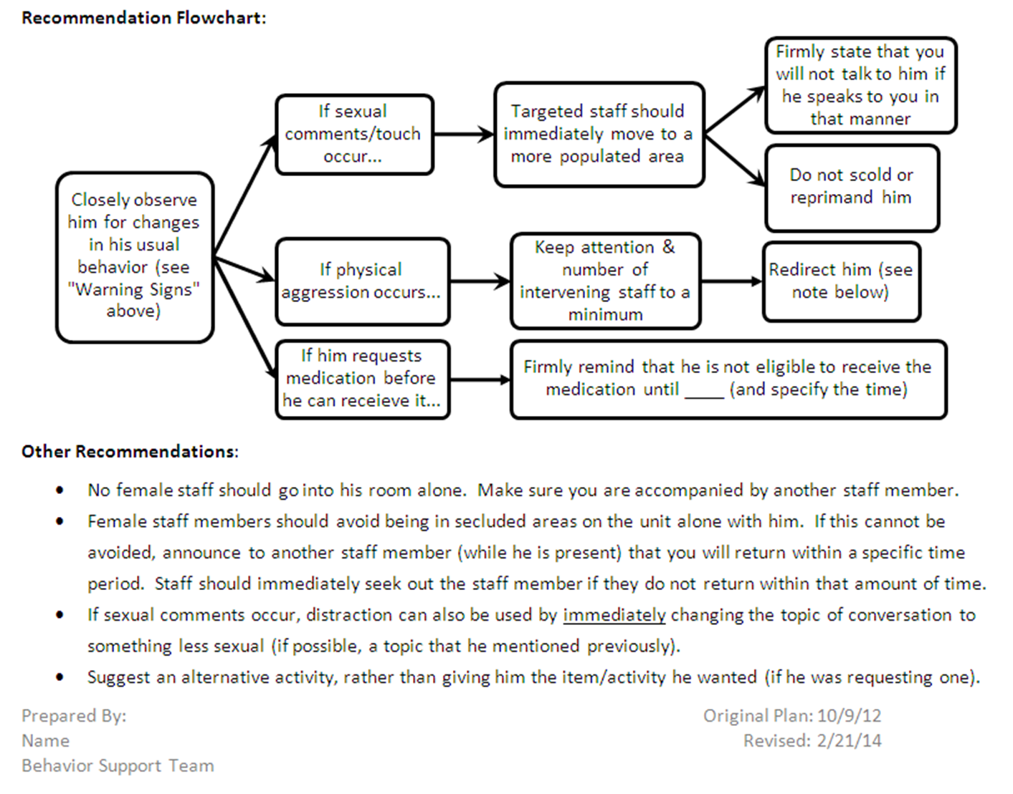
Individualized behavior plan

Slide 13
Data Collection Process
Three data collectors work from 7AM to 9PM
Observations for each patient are scheduled throughout the day, among the three data collectors, using data sheets:
ABC
Frequency
Duration
Momentary Time Sampling (MTS)

Slide 14
A Data Driven Organization
The Behavioral Health department at Kings County Hospital routinely monitors several indicators such as:
Length of stay
Readmission
Incidents
A great interest in understanding the variables that affect aggression and the use of restrictive interventions

Slide 15
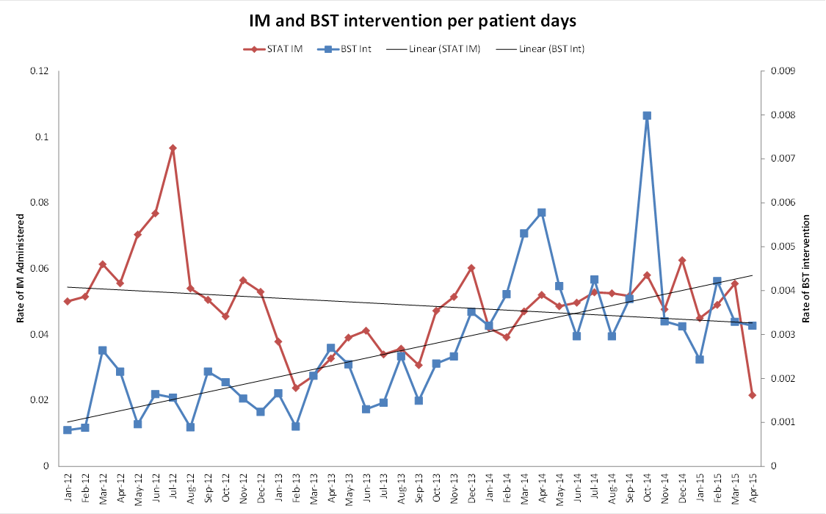

Slide 16
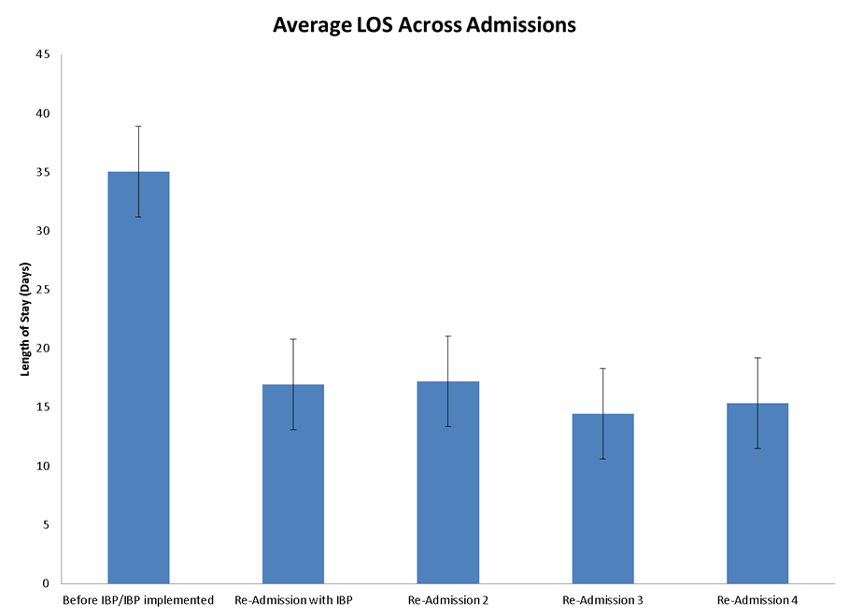

Slide 17
Case Study Using Social Skills Training

Slide 18
Case Study
37 year old female
Long-standing serious mental illness
Schizoaffective / Bipolar Type
Lives at home with her mother

Slide 19
Target Behaviors
Dancing provocatively and singing loudly in hall
Crying loudly and carrying on about her deceased brother (who she thinks she is married to)
Physical Aggression - hitting/biting/kicking
Property Destruction - breaking computers, banging on plexi-glass, etc.

Slide 20
Behavior Escalation Chain
Pacing back and forth in front of nurses’ station→ Requesting items from safe→ Crying→ Accusing staff of stealing her items→ Property destruction→ Verbal/physical aggression

Slide 21
Triggers
Peers taunting her or picking on her
Saying that her deceased brother is actually deceased (she thinks he is alive and they are going to be married)
Discussing her daughter or visitation with her daughter
Denying a desired tangible item

Slide 22
Functional Behavior Assessment
Attention:
Crying, dancing / singing in hall, verbal aggression
Tangible:
Demanding items from safe / property destruction
Escape
Physical aggression - including biting, hitting, kicking

Slide 23
Coping Skills
Cuddling with a stuffed cat
Talking to preferred staff members and doing activities with these staff members
Listening to music
Writing letters in her notebook

Slide 24
Alternative replacement behavior
Asking for a coping strategy (listening to music, journaling)
Writing letters to her daughter or calling her on the phone

Slide 25
Behavioral Interventions
First and Second Admission | Third Admission
Reinforcement of Alternative Behaviors (DRA/DRO), Offering soothing items when upset Offering alternatives when desired tangible cannot be given. | Reinforcement of Alternative Behaviors (DRA/DRO), Offering soothing items when upset Offering alternatives when desired tangible cannot be given. Added social skills training.

Slide 26
Behavioral Recommendations
Check-in’s once per hour, and get her involved in an activity
Differential reinforcement
give attention and praise if engaging in non-target behaviors, dancing/singing/crying/yelling behaviors put on extinction.
When she is demanding tangibles, provide property list and let her know when items can be given.
When the behavior begins to escalate (crying, pacing in the hall),
one staff member with a good rapport should intervene and offer coping tool.
**It was very important that during these crises times that a MALE staff approach her, she had been observed to become more hostile with female staff during these types of situations

Slide 27
Engagement Schedule
Time | Name | Outcome
8:00 am
8:30 am
9:00 am
9:30 am
10:00 am
10:30 am
11:00 am
11:30 am
12:00 pm
12:30 pm
1:00 pm
1:30 pm
2:00 pm
2:30 pm
3:00 pm
3:30 pm
4:00 pm
4:30 pm
5:00 pm
5:30 pm
6:00 pm
6:30 pm
7:00 pm
7:30 pm
8:00 pm
8:30 pm
9:00 pm
9:30 pm
10:00 pm

Slide 28
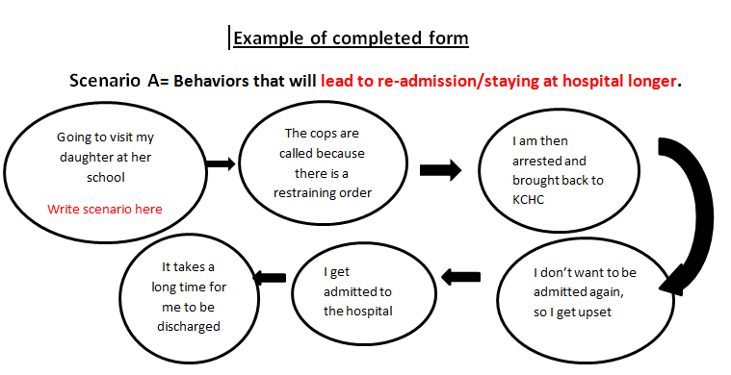

Slide 29
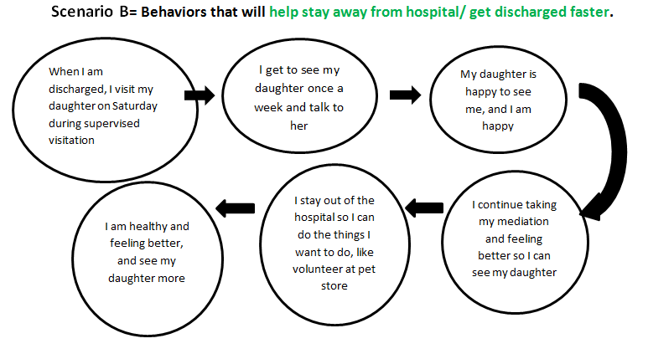

Slide 30
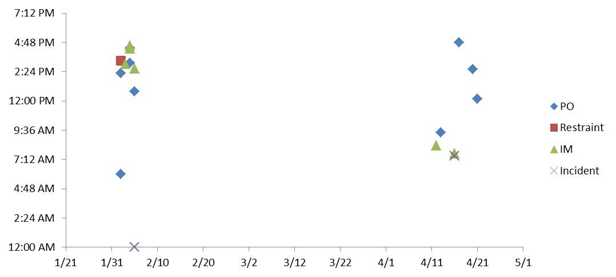
Trigger Alert Graph
Before IBP
IBP
IBP Re-Implemented
IBP and Social Skills

Slide 31
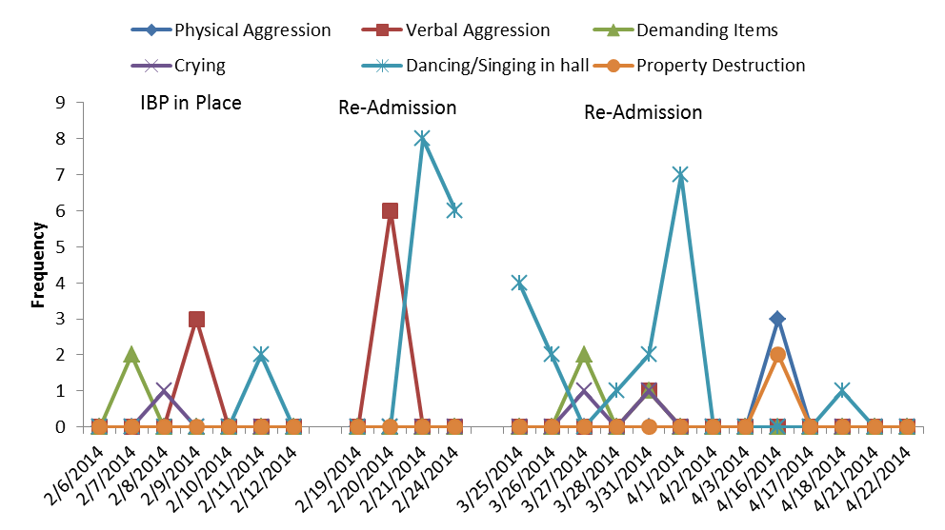
Target Behavior Graph

Slide 32
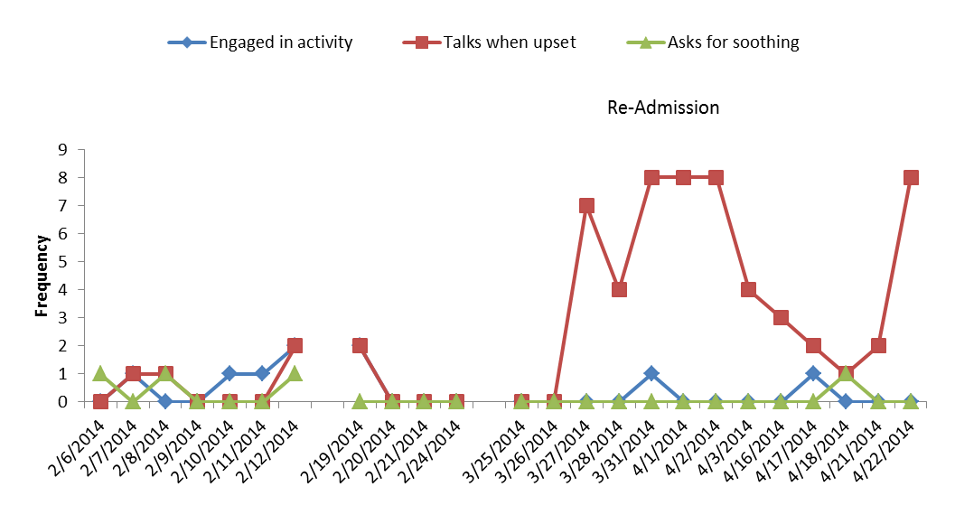
Alternative replacement behaviors
IBP in Place
Re-Admission
--Social Skills

Slide 33
Summary of results
Before IBP:
8 restrictive interventions (i.e., stat intramuscular medication injections, 4 point restraints, and manual holds) were used.
After IBP:
Target behaviors decreased to 1 or less instances per observation and restrictive interventions decreased to zero levels.
3rd Admission (IBP and Social Skills):
Substantial increase in alternative replacement behaviors and no further restrictive interventions were needed.
Behavioral interventions in acute psychiatric settings:
decrease the occurrence of problem behaviors and restrictive interventions
increase pro-social alternative replacement behaviors that can be generalized to settings outside of the hospital.

Slide 34
The lasting effects

Slide 35
Lasting effects – Other Hospitals in the community

